Slide 1
Example of citizen activist use of OpenData against a project of french government decree on advertising regulations : true, recent (and well ending) story !

Slide 2

- To protect lanscape against the proliferation of advertising billboards
- Only legal actions : awareness, mediation, files to courts
- Successfull organization : 71 successes in trial (on 71)
- Non profit, no subsidy, only volunteers
Notes:
Paysages de France
- French non profit organization which advocates the landscape against the proliferation of advertising billboards, (rules exist but are not respected).
- Association approved at the Ministry of the Environment
- Only legal actions : awareness campaigns, training actions, mediations
- Investigation files to courts : managed to condemn the french state 71 times, 71 successes on trial on 71 attempts : succeeds in removing thousands of unlawful billboards from the french lanscape
- Non profit organization, no subsidy, only volunteers

Slide 3
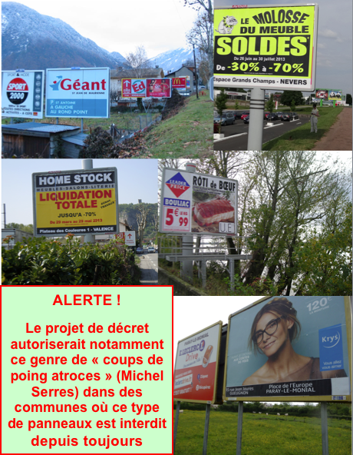
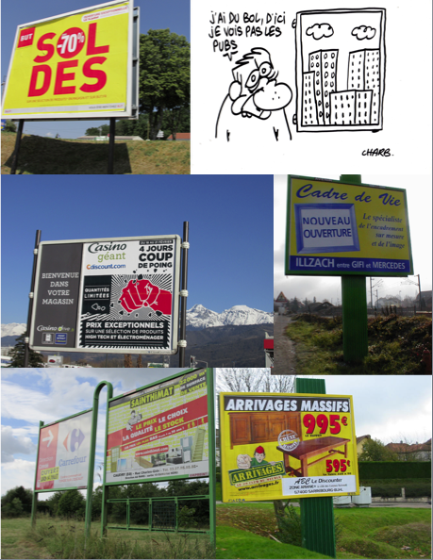
A government decree project in 2015 promises large landscape horrors everywhere !!
Notes:
But advertising lobbies regularly want to make evolve regulations in their favor, that's what happen in sept 2015.
A project decree has been prepared in French ministry of Economy, and almost sure result of the work of lobbies which regularly want to make evolve the regulations in their favour. Advertising lobbies are very powerful, large financial interests are at stake. Several companies, subsidiaries of large american companies.
Several new articles want to challenge and destroy current regulations.
But project decree is unclear, difficult to understand, it adds complexity, and it is not evaluated at all. Impossible to understand what it means, impossible to know the exact impact.

Slide 4
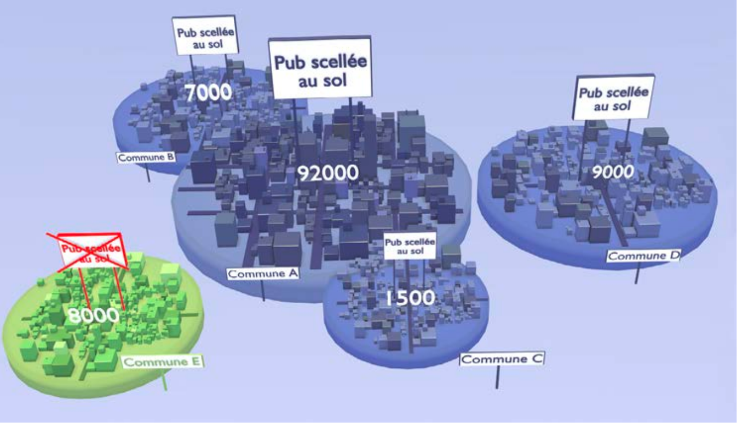
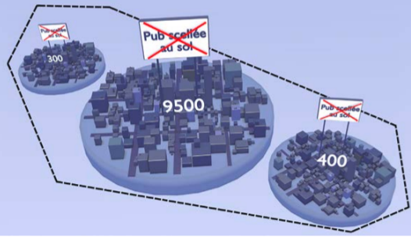
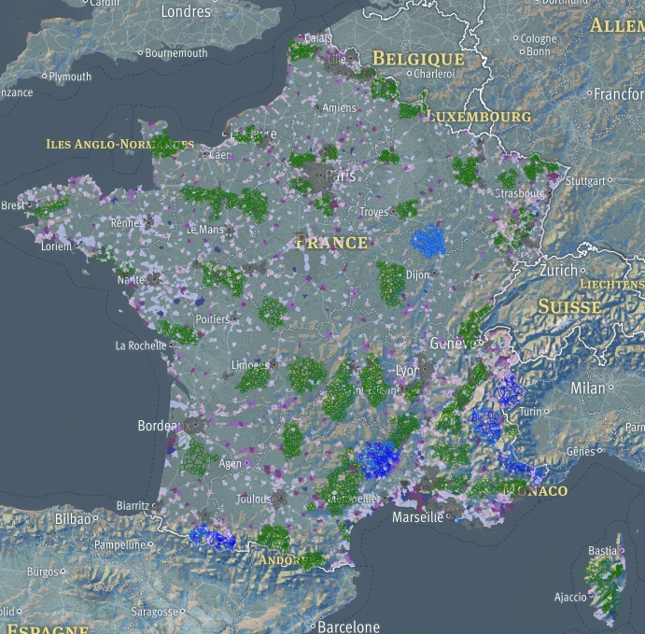
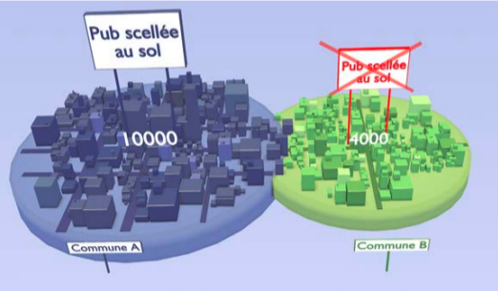
Explanations of current rules, and what was supposed to change
<=
This was supposed to change, but was not evaluated
Notes:
Today grounded advertising billboards are totally forbidden in rural space, outside or urban area.
Today grounded advertising billboards are authorized in the 61 french urban entities which have more than 100 000 inhabitants
Today grounded advertising billboards are authorized
in the more than 500 cities which have more than 10 000 inhabitants.
Project decree wanted to extend the authorization of grounded advertising billboards to all cities which are part of a urban entity, which center town has more than 10 000 inhabitants.
Data to know the impact did not exist and needed to be computed by taking into account definition of french urban entities, population of towns, we needed to separate the place where it was already authorized from the place where it would have become authorized.
Moreover we needs to know all the towns which are part of a Regional Park and part of a urban entity of a town with 10 000 inhabitants or more
Several open data files (from Etalab) processed (urban entities,cities, populations of cities, regional parks definitions) to compute list of cities impacted.
Processings were done in bash to decorate vectorial map file, to build a Mapbox map with OpenStreetMap rendering.

Slide 5
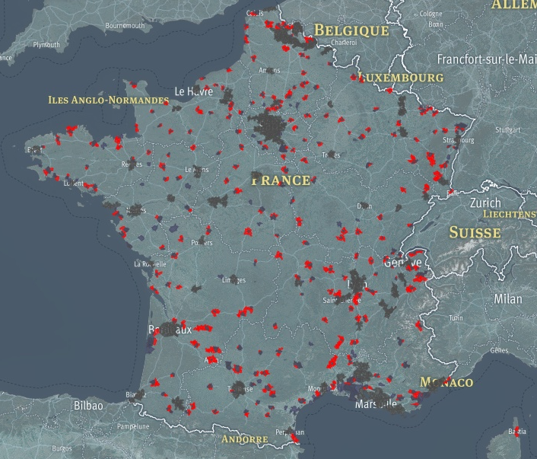
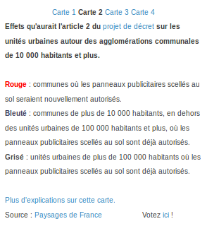
October 2015 : opendata & map
Notes:
The result is that 237 urban entities and 1149 cities are concerned !!
See map for french metropole
See map for Guyane/Guadeloupe/Martinique
See map for Reunion Island and Mayotte

Slide 6
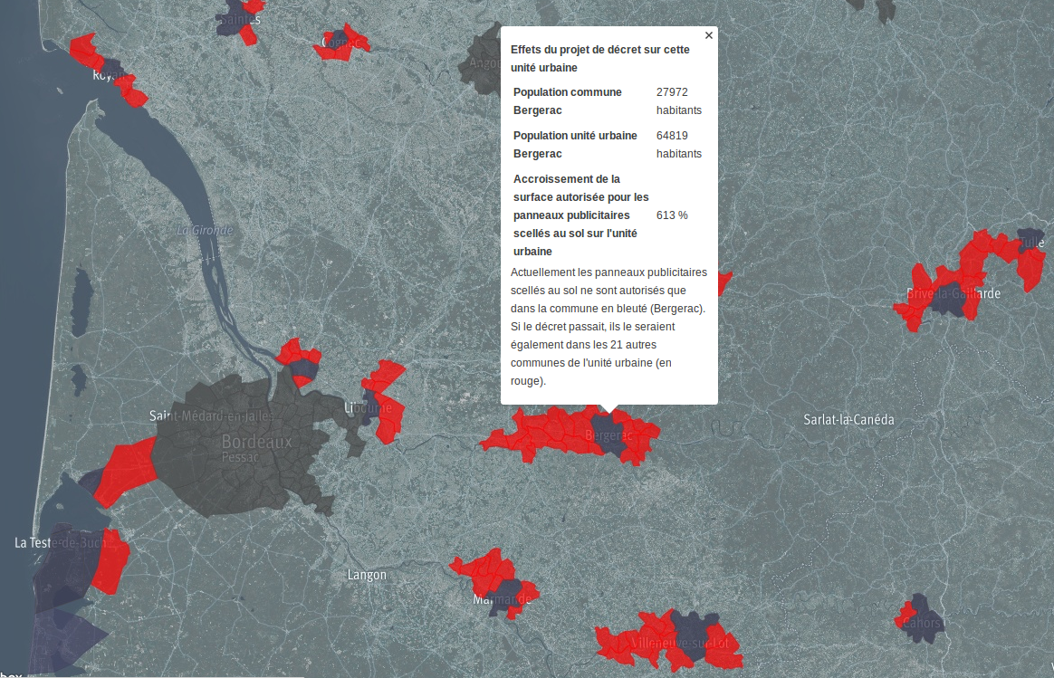
October 2015 : interactive map covers all France, and show impacts for each town, each region. So everyone can realize !

Slide 7
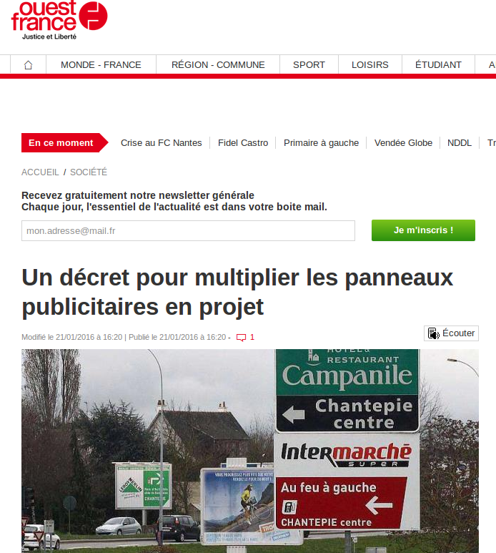
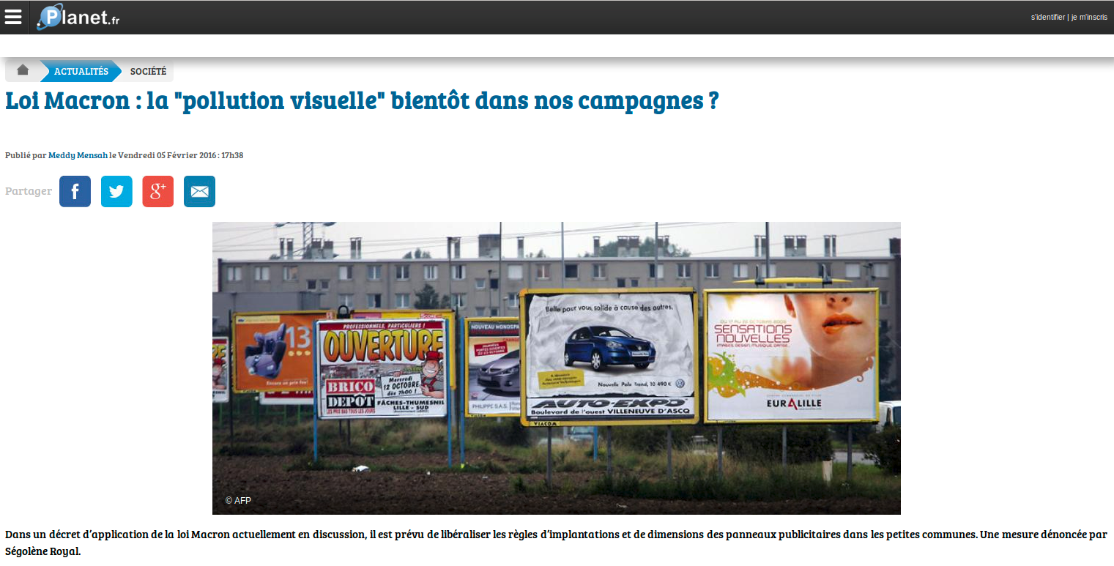
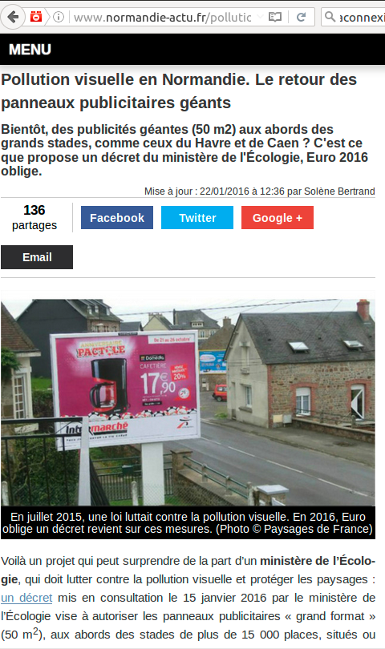
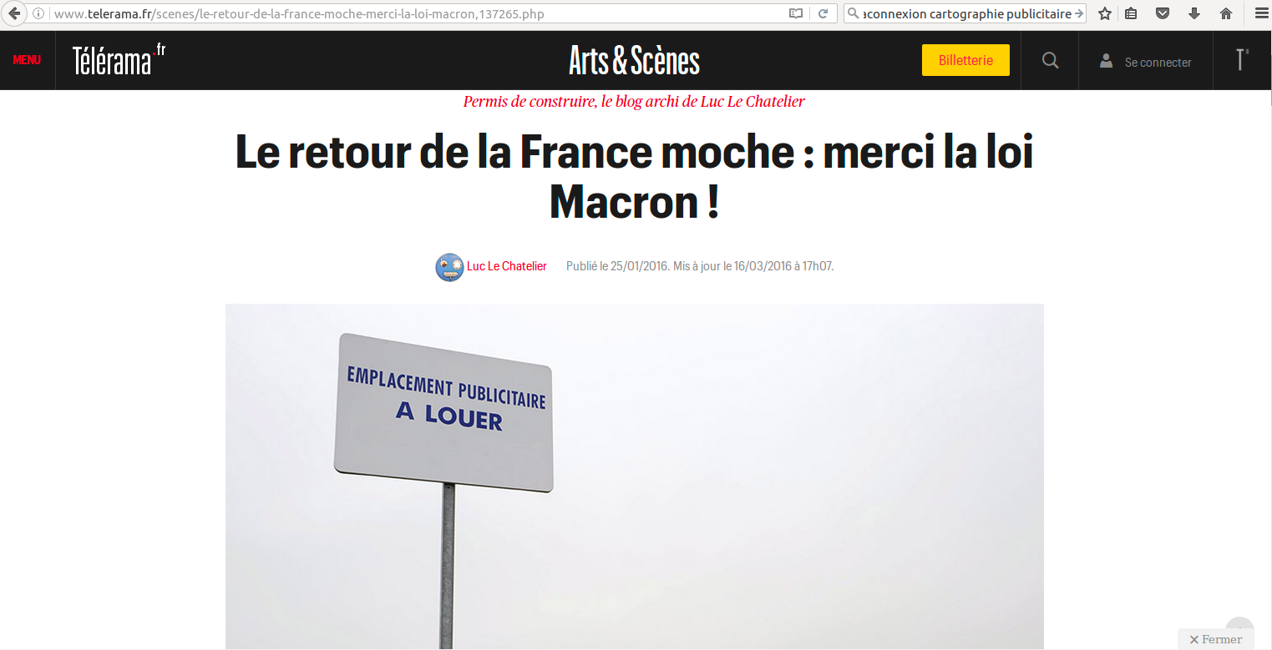
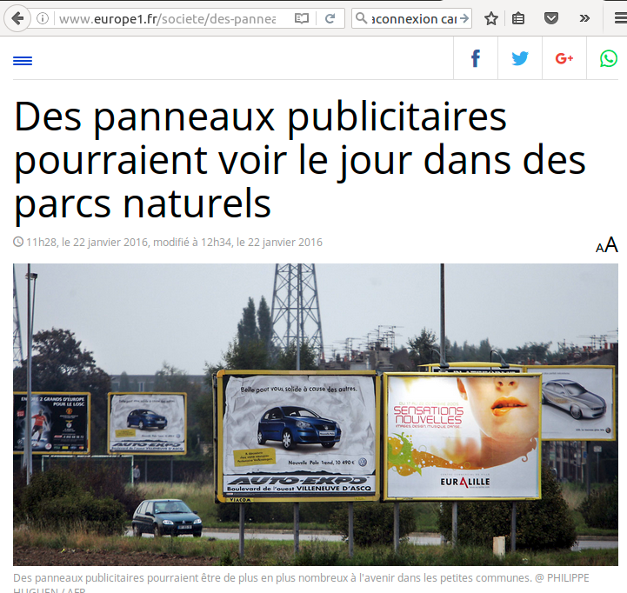
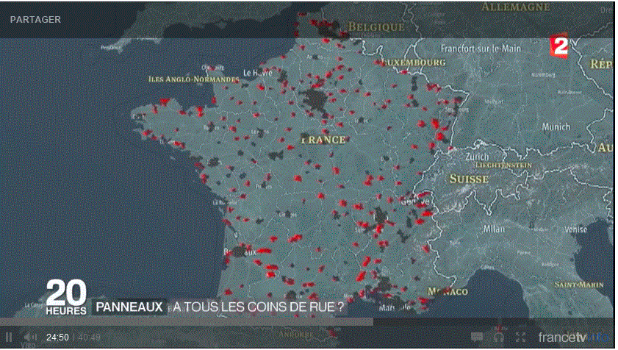
January 2016 : media bring the debate to the public space

Slide 8

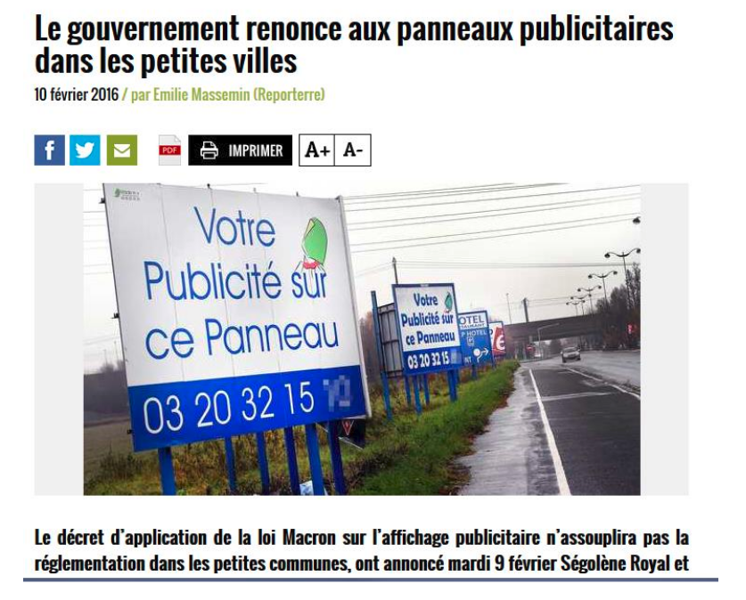
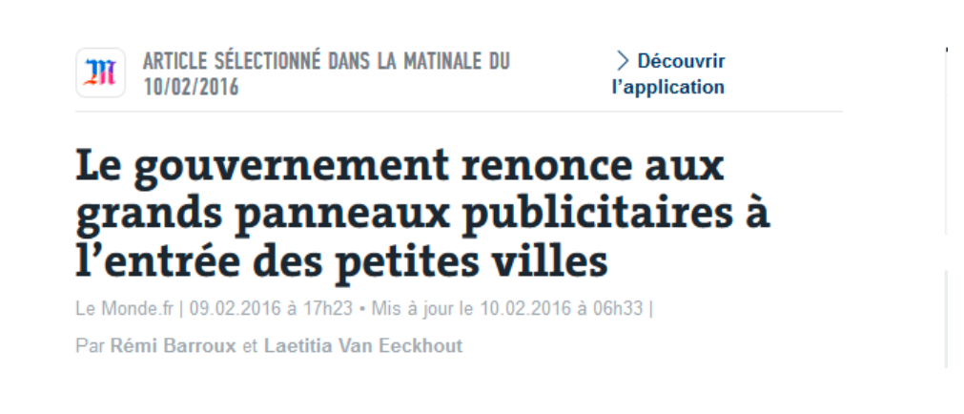
February 9th 2016 : government gives up, victory !!!

Slide 9
Progression of the fight

Slide 10
Welcome page of project http://pdfext.github.io/index.html
Participation to Etalab dataconnexion#6 contest https://www.data.gouv.fr/fr/reuses/evaluation-et-visualisation-dun-projet-de-decret-sur-laffichage-publicitaire/
Paysages de France : www.paysagesdefrance.org

